Slide 1
ONLINE HOME SERVICES

Slide 2
PROJECT DESCRIPTION
The aim of the project is to make common man’s life easier. Here the customer is provided with online web application where he can easily select his problem regarding home services such as washing machine repairs, electric repairs, plumbing fixes etc..and can get our doorstep services at reasonable charges.
When we observe Home repairs we fix that issue by contacting workers, but here the problem arises that workers may not be available or when available they charge high amount of money even for small repairs. Then we solve that issue by searching for workers who satisfy us. The customer here gets our services at doorstep 24/7 at reasonable charges.

Slide 3
Whereas technologies are used while implementing the project. For the frontend HTML and CSS are used. In the backend, JavaScript and for the database, MYSQL is used.

Slide 4
TEAM MEMBER CONTRIBUTION
MEMBER NAME | ROLE | NOTE (IF APPLICABLE)
Pavithra | Frontend
Anusha | Frontend/Backend
Akhila | Frontend
Srujana | Frontend
VivekVardhan | Backend/Database
RajaShekar Reddy | Backend/Database
Harshit Reddy | Frontend
Anwar Hussain | Backend/Database

Slide 5
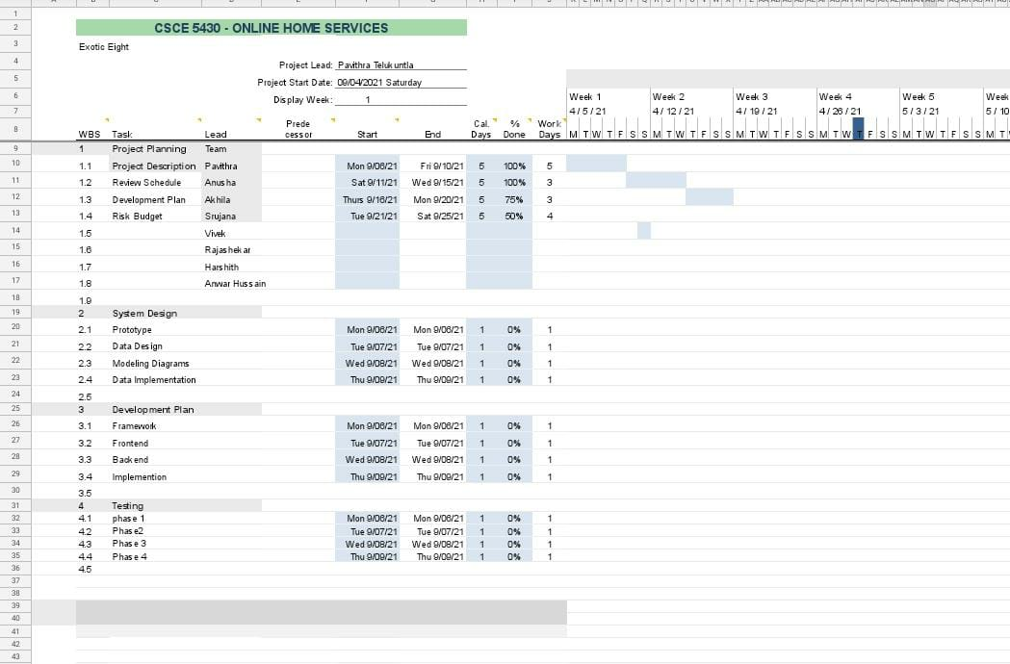
Gantt Chart

Slide 6
Risk Management
The first risk would be breach of customer personal data to the workers / staff / or customer safety in case of any unexpected circumstances. We plan to manage the risk by having background checks on every employee and proper training before assigning work.
The second risk could be payment issues or feedback issues from both customer side and the worker side. An encrypted payment setup will be used for secure payments and customer feedback / customer query option is provided for any issues faced.

Slide 7
The third risk is there exists lot of bugs in the main module which results in change of code at the last. To avoid this we are planning to test a code multiple times with different personal before execution and final submission.

